Slide 1
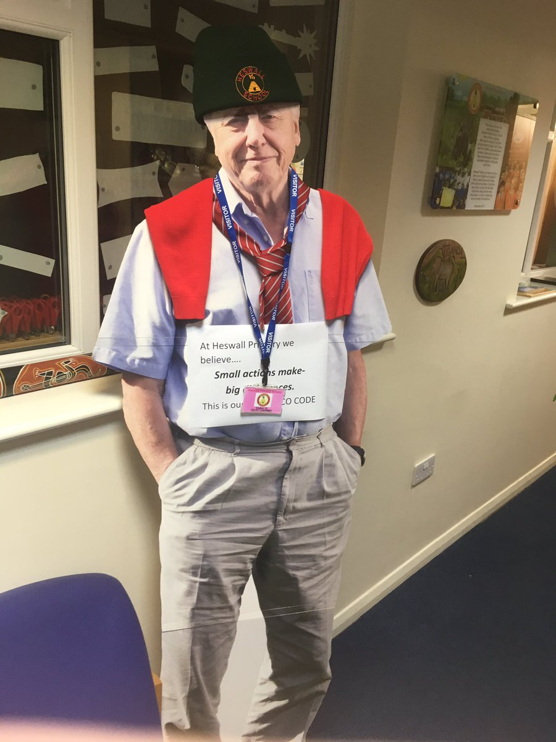
Welcome to Heswall Primary
We believe...small actions make big differences ... This is our ECO CODE.
We have 3 main
Eco Schools priorities

Slide 2
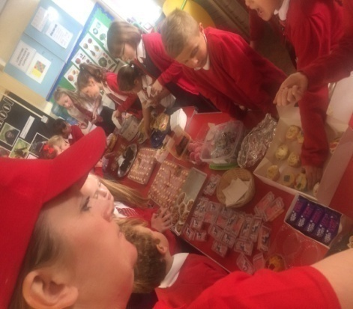
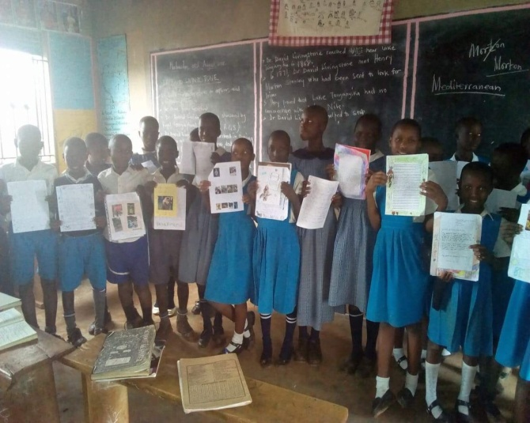
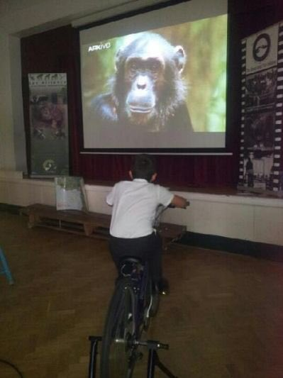
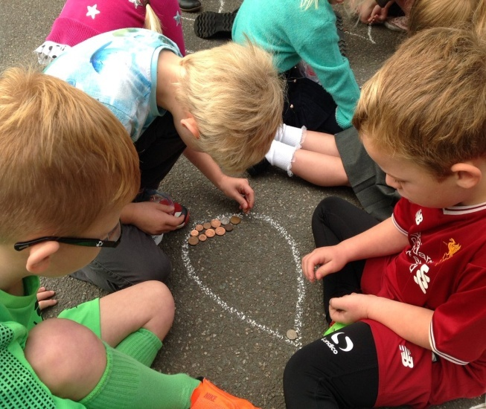
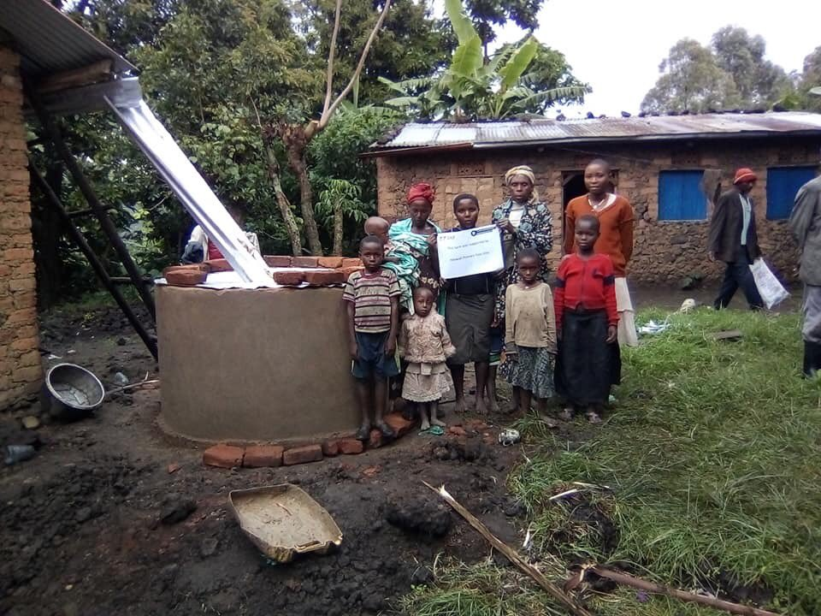
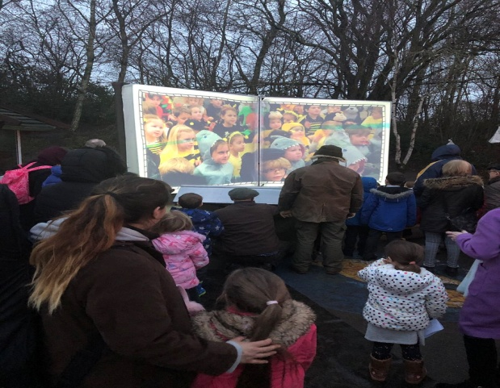
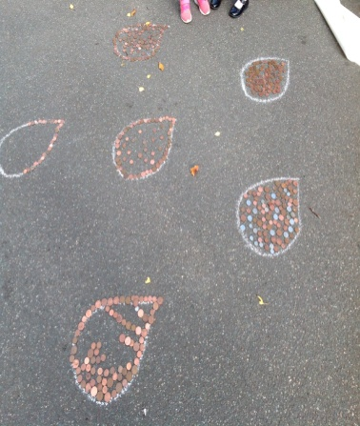
Global Citizenship
Funding of film showing and tree and cabbage planting
Letter writing to twin schools and conservation projects about endangered animals
Fundraising for water tanks.g
Conservation film makingg
PRIORITY 1

Slide 3
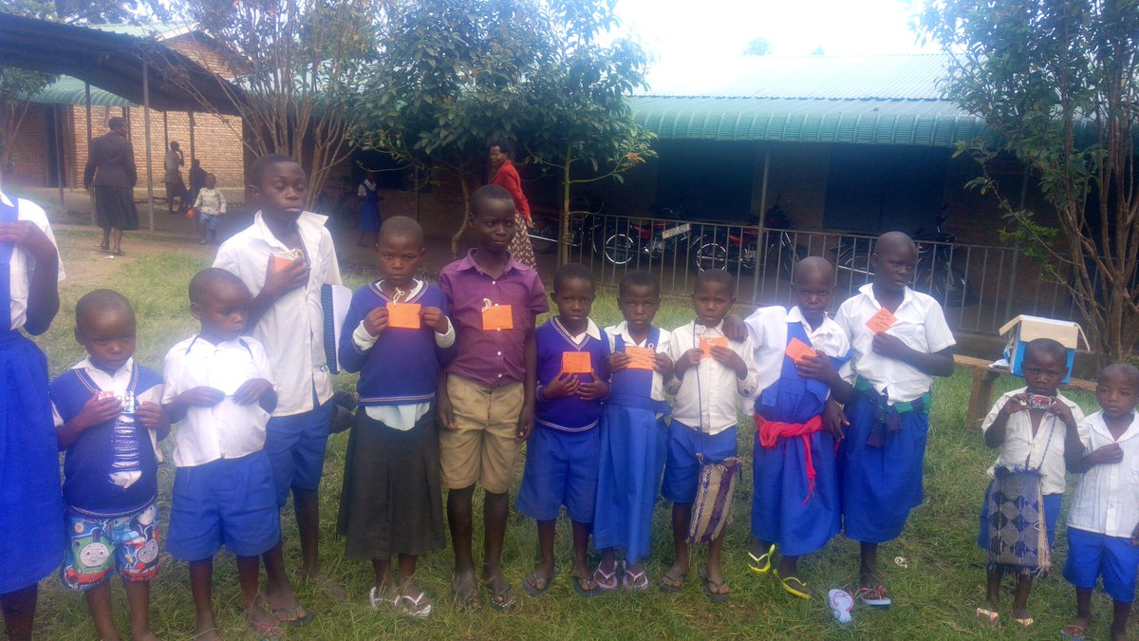
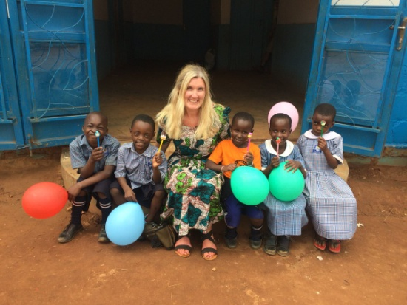
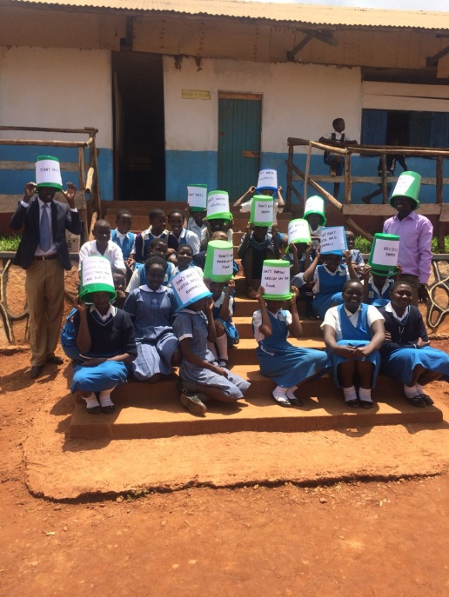
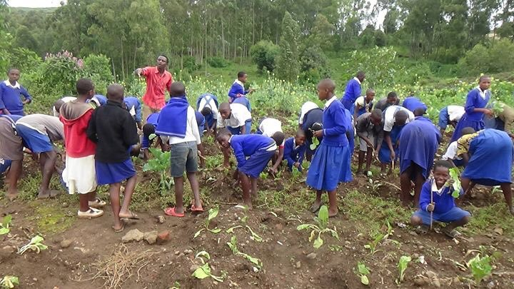
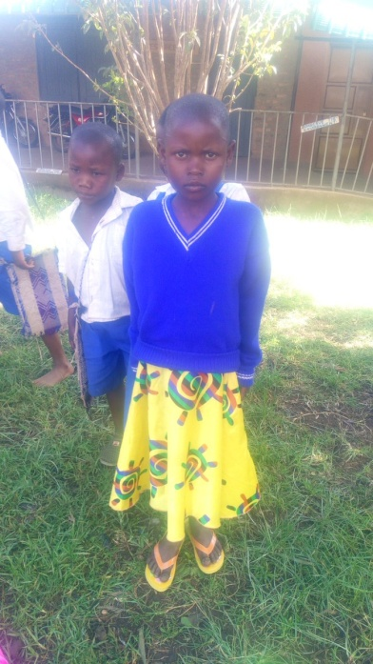
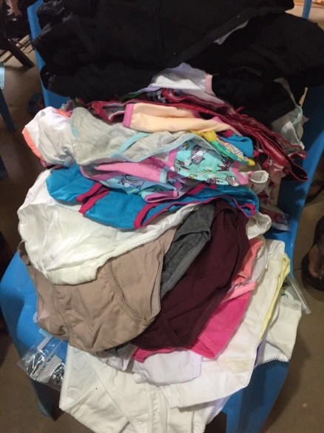
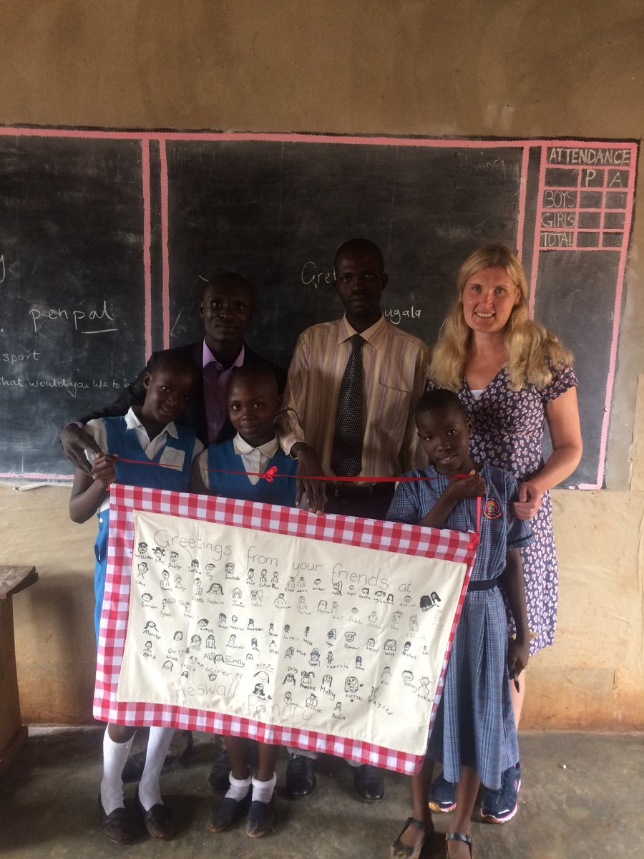
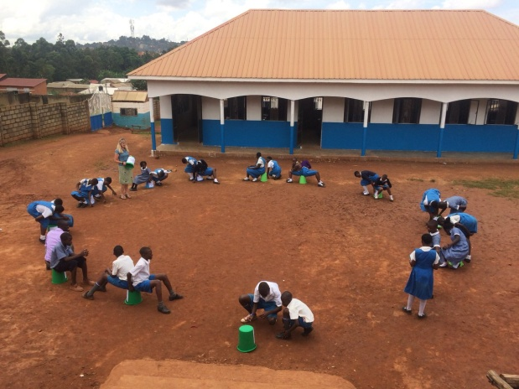
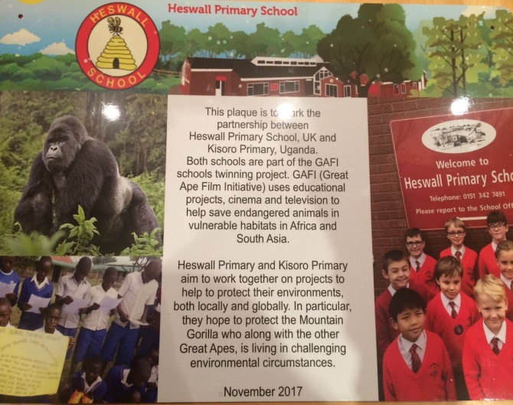
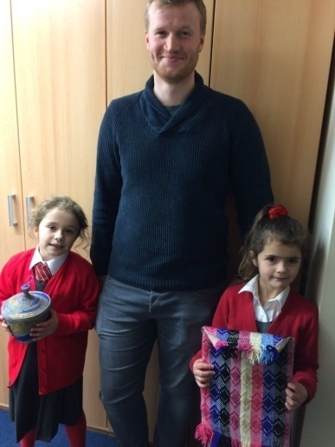
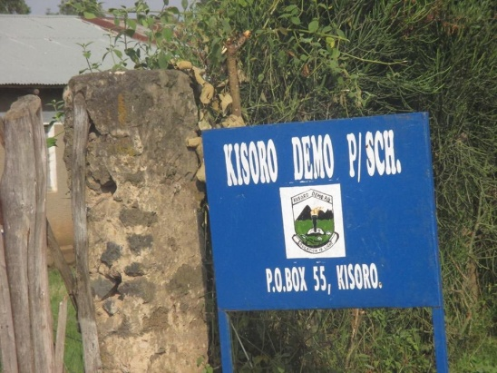
Feedback from Kisoro Primary, "The children at Kisoro Demo were so happy. Some of them have never put on shoes and their families are so vulnerable, they were scared to have them in their feet. There are many more families in need of footwear."
Teaching Heswall conservation values in Bucket Schools in Uganda
Donation of underwear and flip flops.
Twin sign

Slide 4
Alongside 6 local schools and supported by DRIP Uganda, we raised money for 58 water harvesters for our twin schools in Uganda. NEXT STEPS: We would like one in our own school
Priority 2:Water
River of pennies

Slide 5
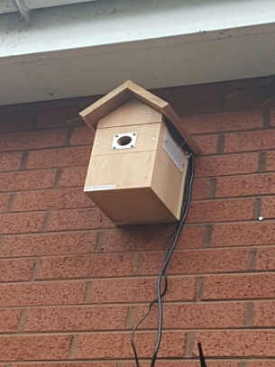
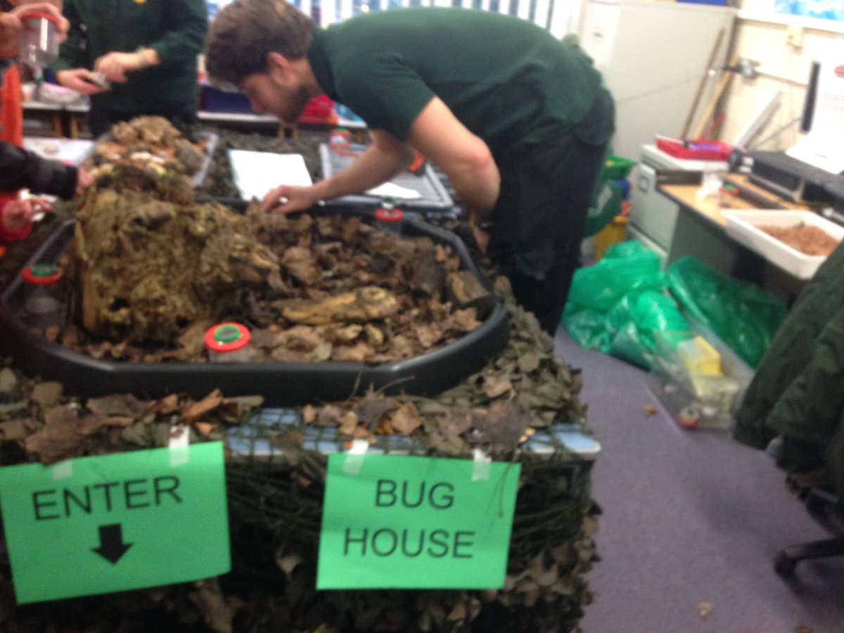
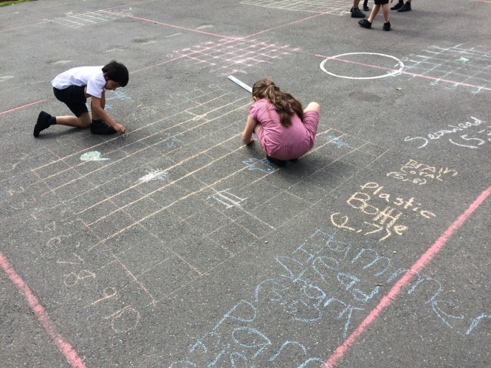
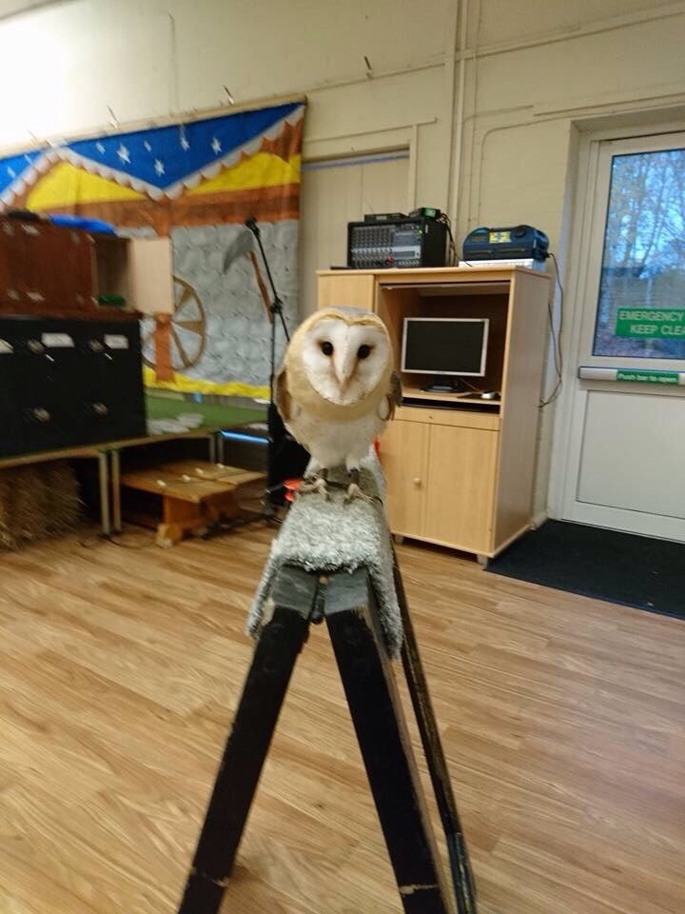
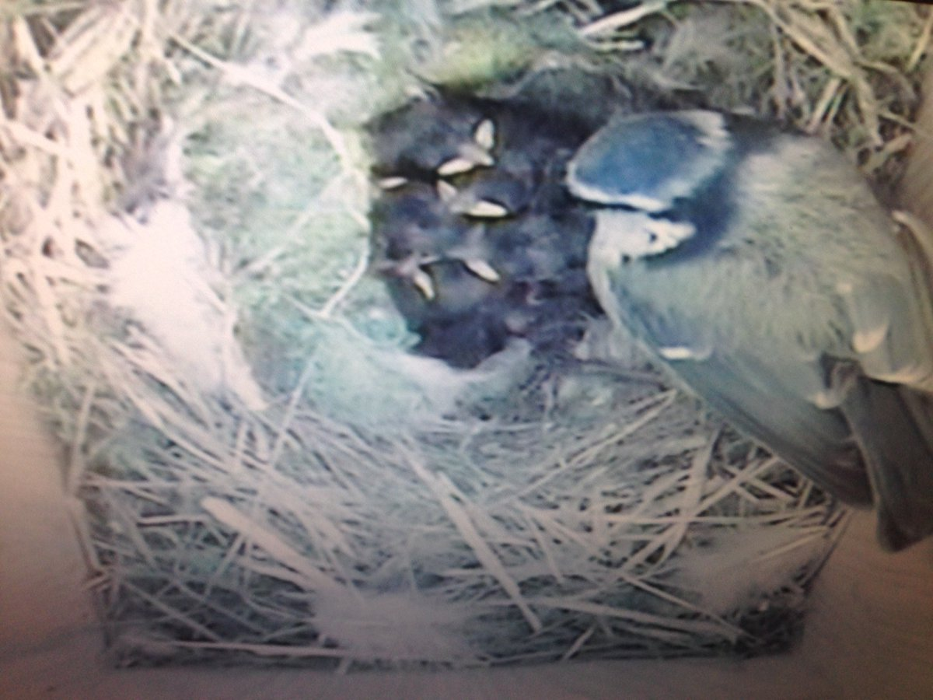
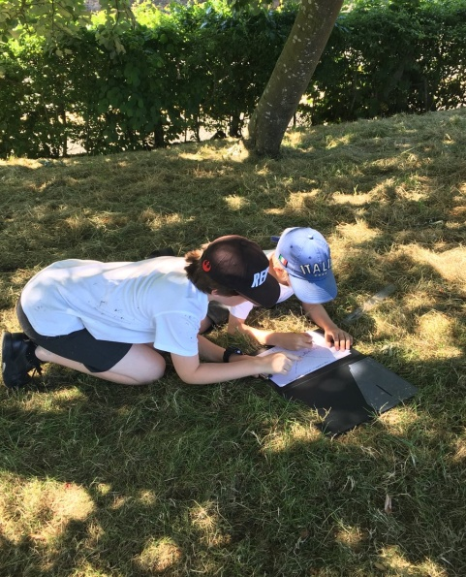
Priority 3:Biodiversity
Building habitat piles in Nature Club and during Science Under the Stars.
Camera nest box
Owl Pellet Dissection to discover what barn owls in Heswall eat.
Outdoor maths: Graphing animals found in our local environment
Minibeast Hunts- OPEL audit feeding to National Data
We believe...small actions make big differences ...

Slide 6
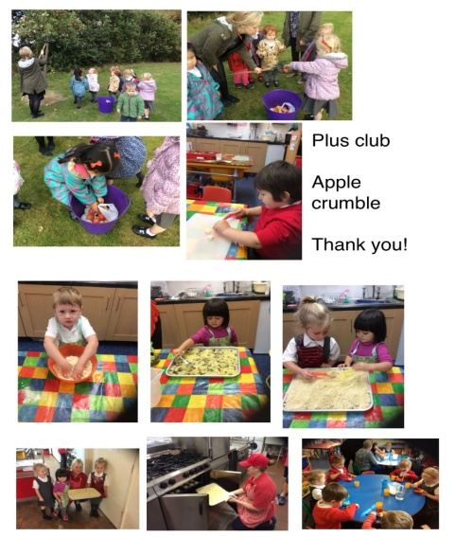
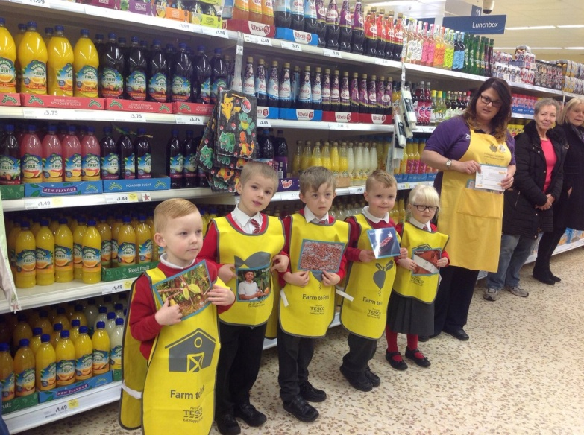
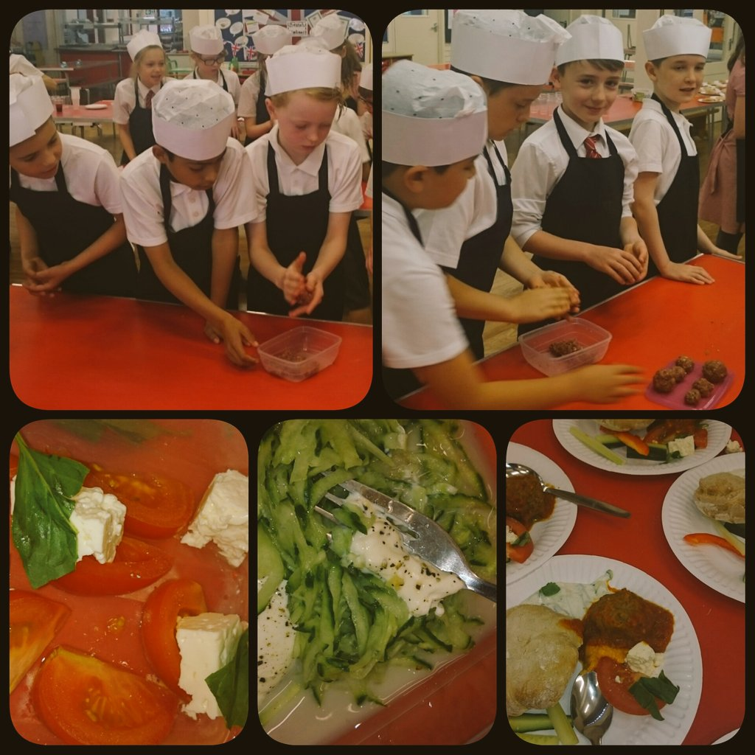
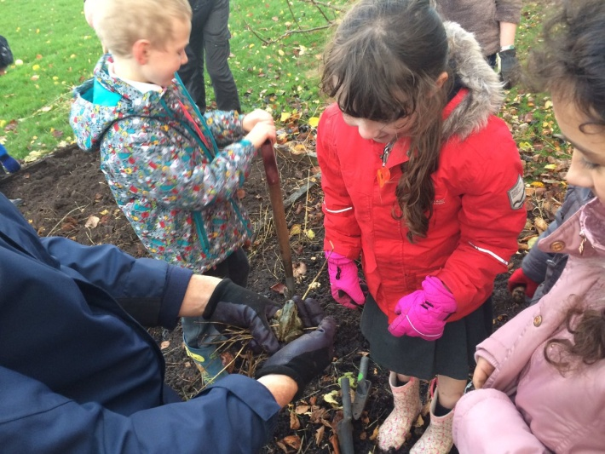
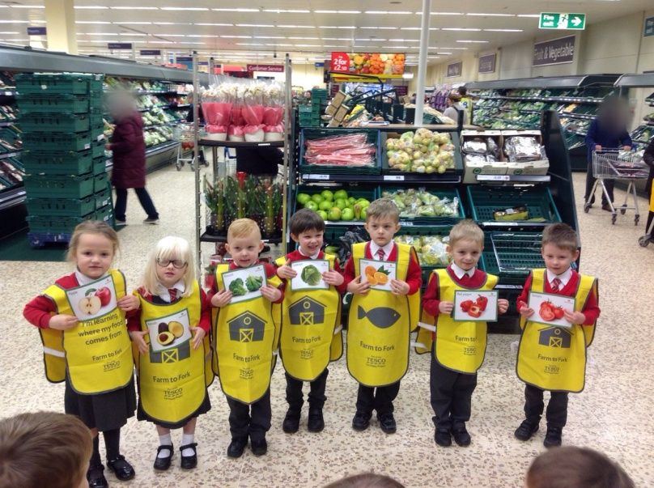
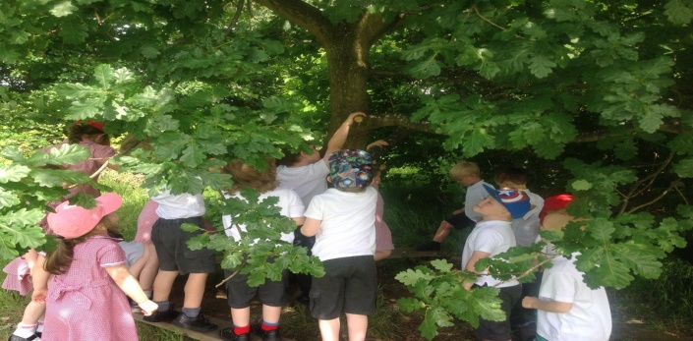
Healthy Living
Learning about Fairtrade
Learning about local produce and using it to cook.
Growing produce in school allotment
Next steps
Growing plants for canteen in the allotment
Eco Team to research plants that children would like to eat.
Harvesting apples and fruit to make jam.

Slide 7
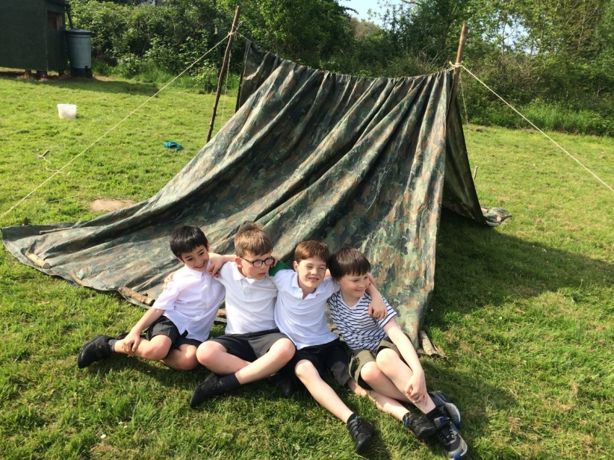
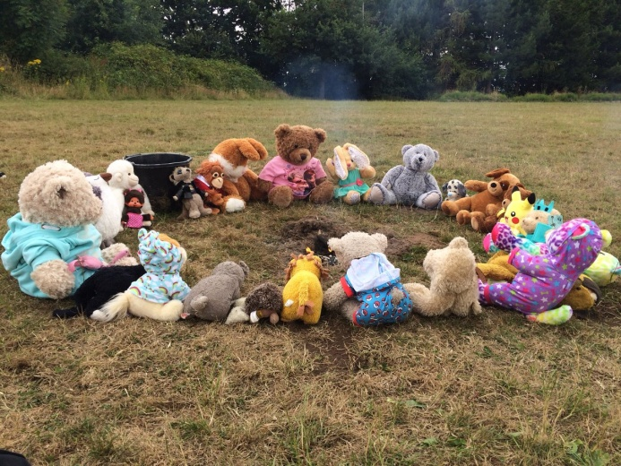
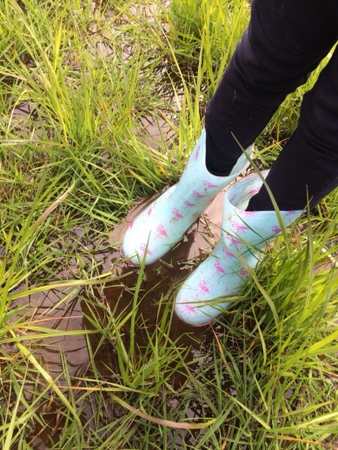
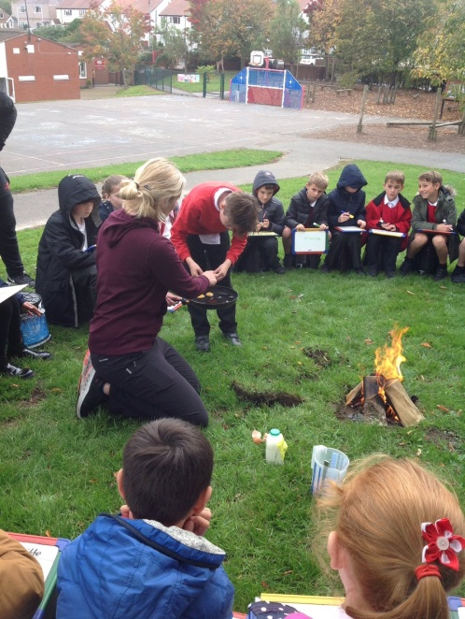
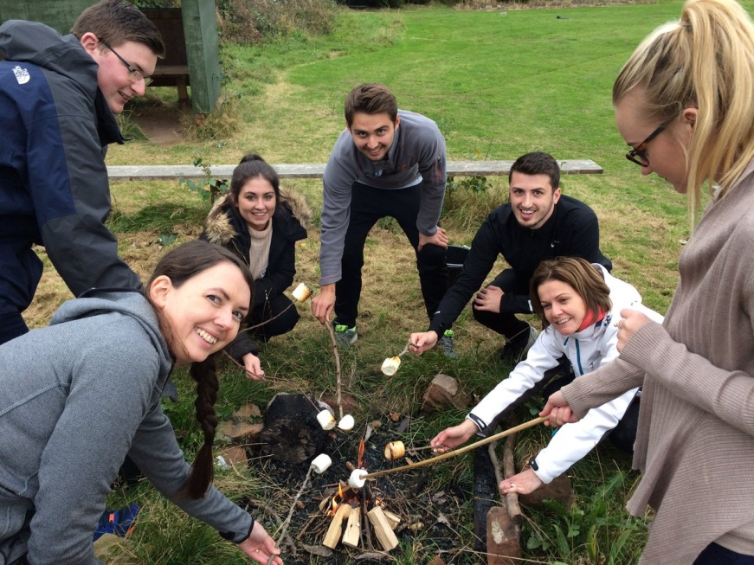
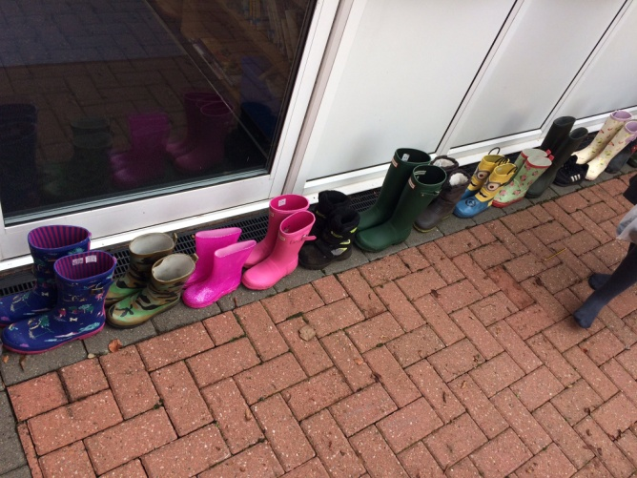
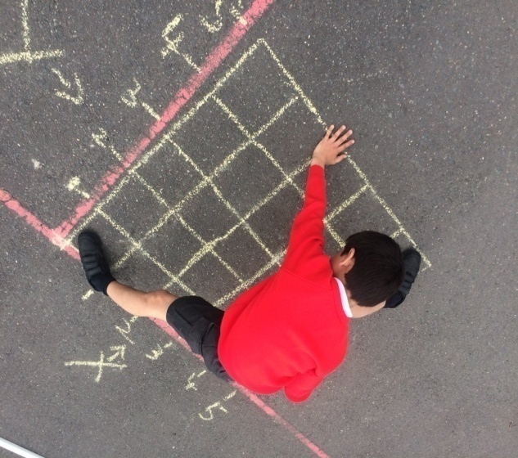
School grounds
Bushcraft training
Bucket School
Golden Ticket treats
Maths of the Day outdoor learning
Training student teachers to work outdoors

Slide 8
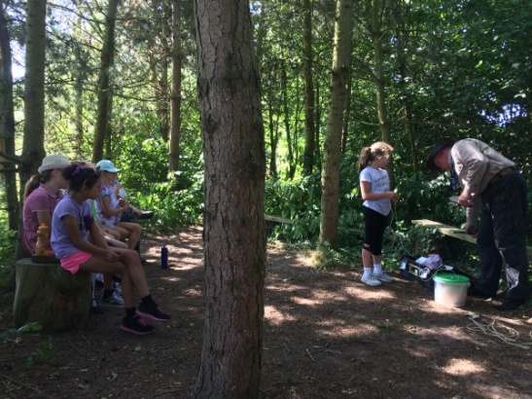
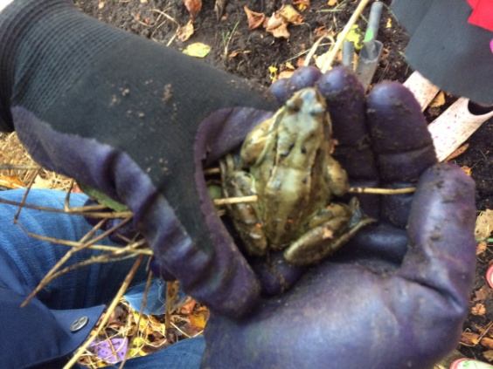
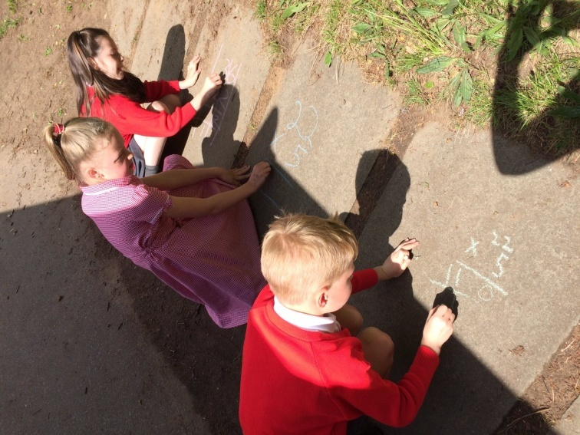
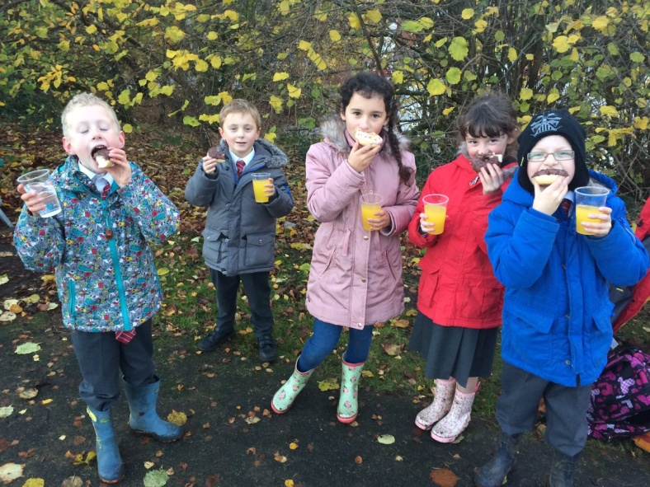
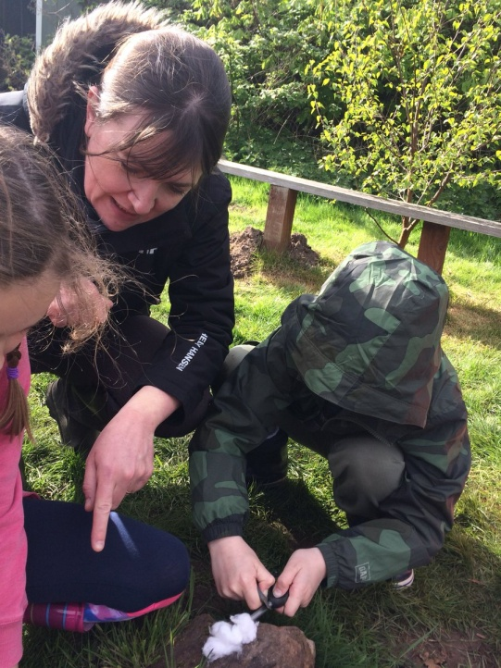
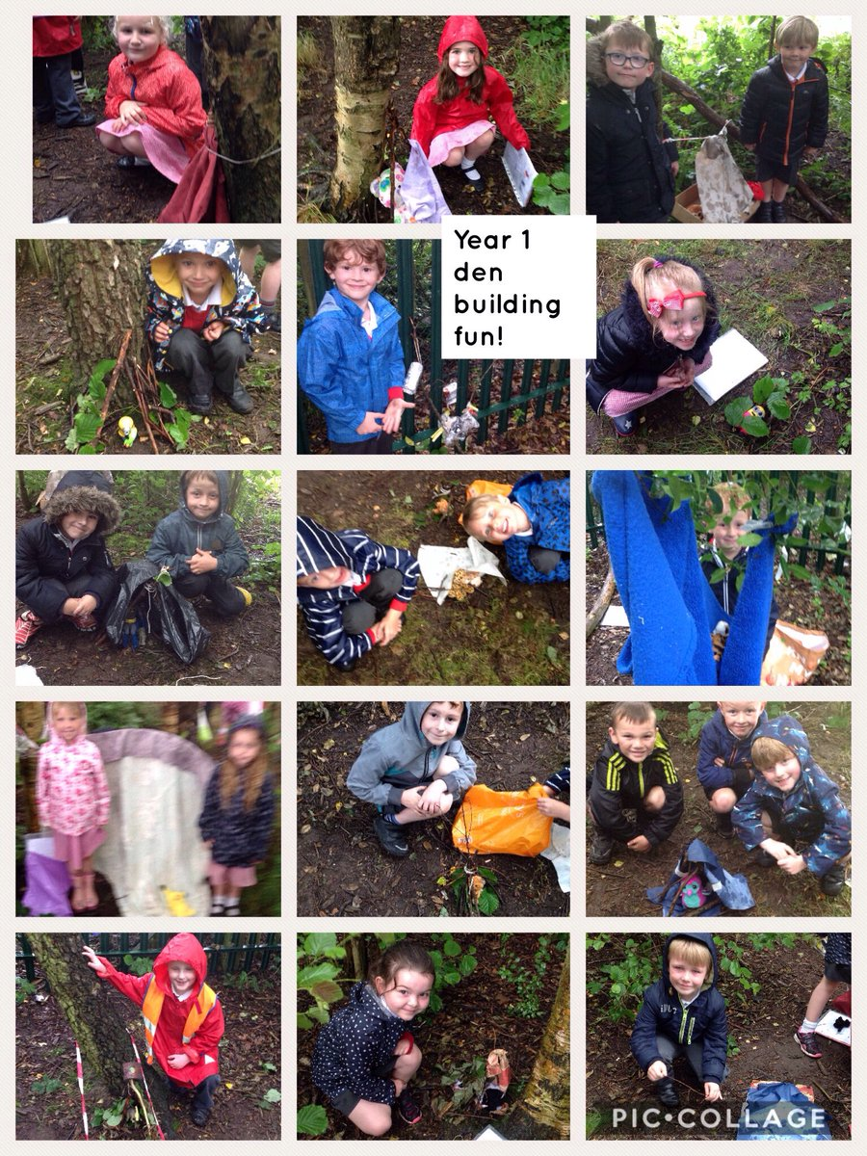
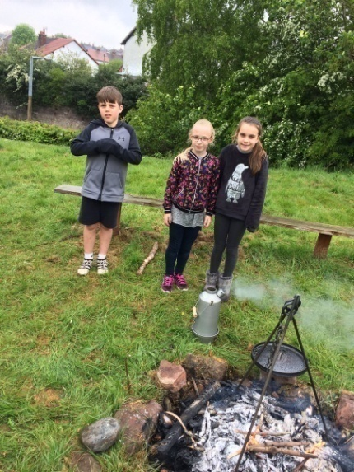
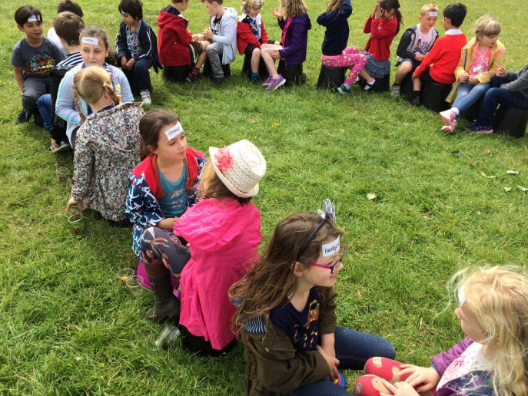
Outdoor classroom Dayday
Bucket School
Den Building Day
Holiday homework

Slide 9
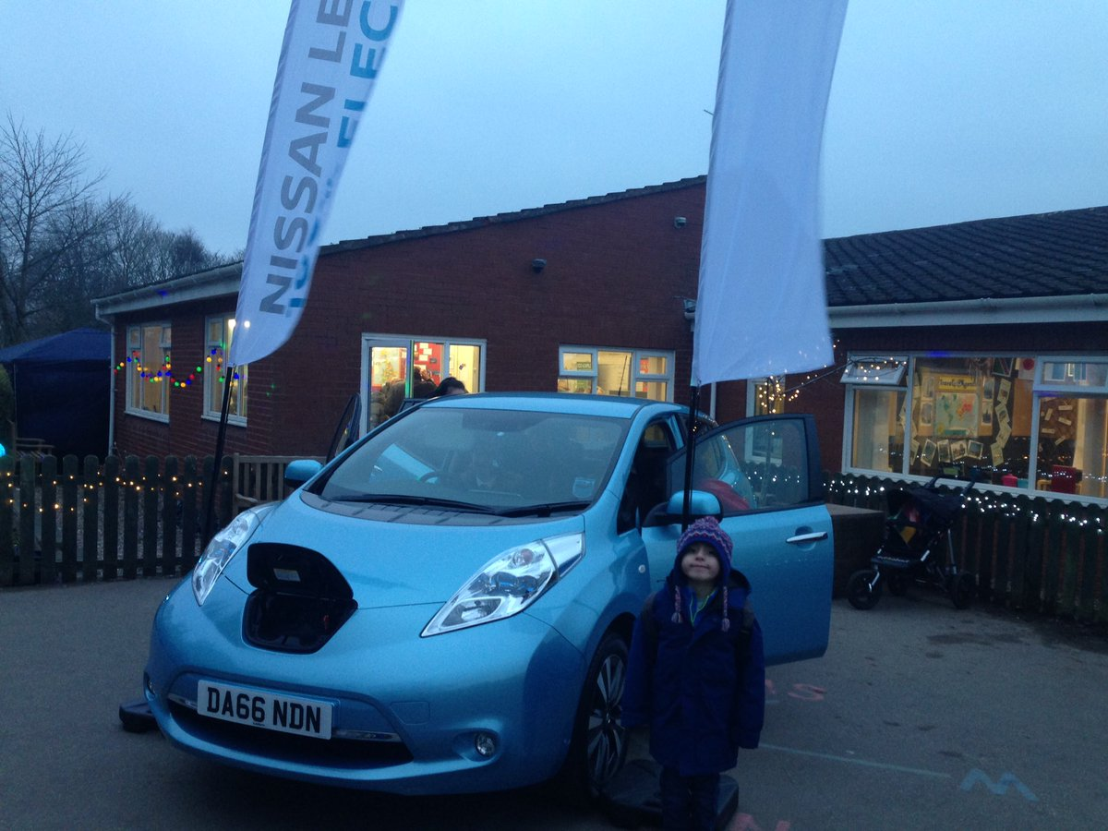
Transport
What’s happened so far this year?
No parking pupil campaign.
Invitation to WSUS of green vehicles.
Next steps: Walk to school discussion at School council meeting needed again..
Renew graphing system for ‘Walk to School? Or decide new method
...

Slide 10
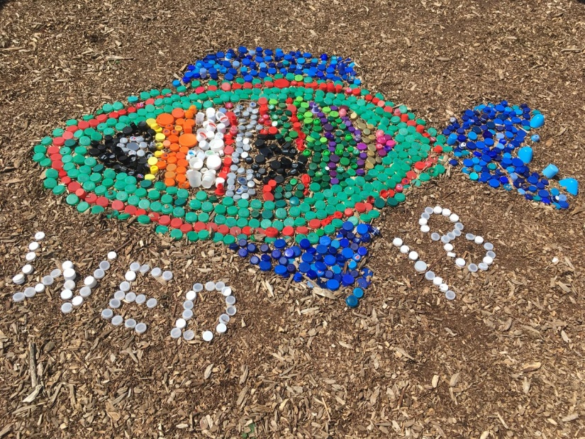
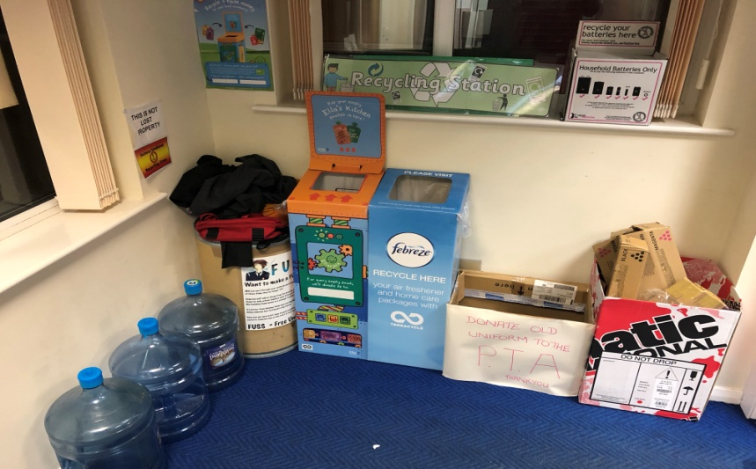
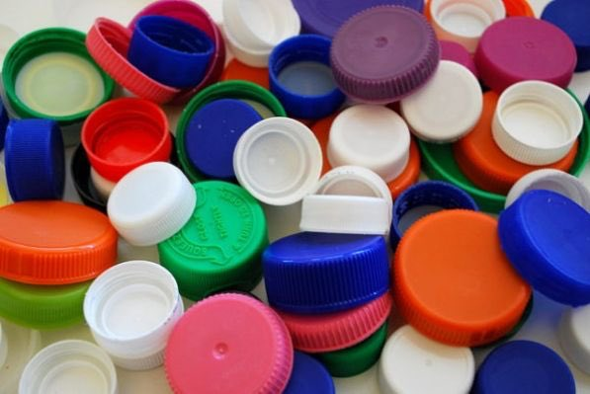
Recycling points in school for:
Sweet wrappers
Uniform
Plastic bottles
Biscuit wrappers
Computer cartridges
Ella’s kitchen
Batteries
Waste
Next steps:
Eco team to investigate more potential recycling firms led by Mrs W.
Continued composting of food waste.
Collection of bottle tops for WED art.

Slide 11
Energy
Assemblies to discuss saving energy and switching off lights at home and at school
NEXT STEPS:
Light monitors to check
classrooms at lunch times.
Discussion to take place with caretaker to review access to meters for meter readings after failure to install effective system last year.
Switch Off Fortnight
...

Slide 12
New film here
And here...
Click here
to watch

