Slide 1
‘Helping Your Child Thrive’ Workshop for Parents
Primary Mental Health Team
Child and Adolescent Mental Health Service (CAMHS)

Slide 2

What to Expect from Today…
Ideas on how to build your child’s resilience
To know what to look out for regarding your child’s mental health
Ideas on talking to your child about mental health
Notes:
Please fill in level of confidence at beginning and end

Slide 3
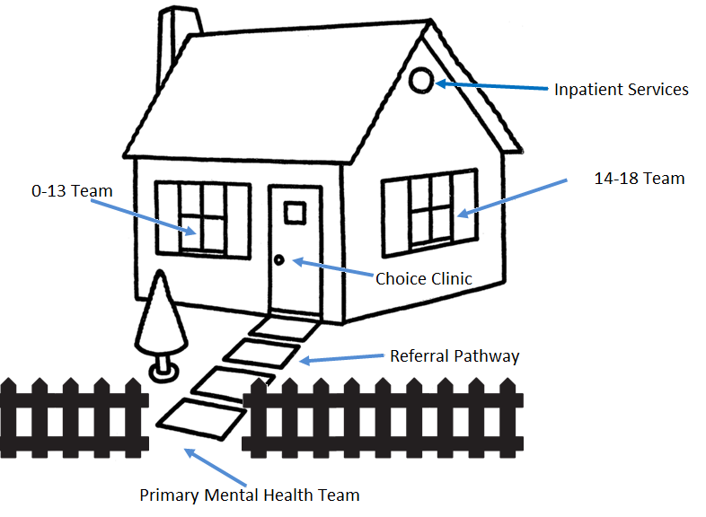

What is Wirral CAMHS?
LD CAMHS
LD CAMHS
LD CAMHS
LD CAMHS
LD CAMHS
LD CAMHS
Notes:
We are Primary Mental Health Team – gate keepers for CAMHS . CAMHS is a specialist mental health service for children who need a specialist service (severe mental illness)
Offer training/ consultations with professionals working with young people and families
Mental Health is everybody’s business – school. Family, community, children themselves
LD CAMHS set to appear on click or after 30 seconds.

Slide 4
What is Mental Health?
Being able to:
Develop and thrive
Make and keep friends, and understand what makes a good friend
Use and enjoy time on our own
Empathise with others
Play and learn
Develop a sense of right and wrong
Resolve problems and setbacks and learn from them
Notes:
Positive mental health is not about being happy, it is about being able to cope with difficulties. When might a child be unhappy without it being a mental health problem (normal reaction to circumstances or events)

Slide 5
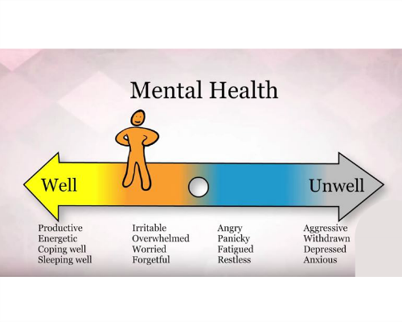
What is Mental Health?
Notes:
Mental health continuum – we are all on here and we can all move up and down the continuum constantly.

Slide 6

What is Resilience?
Resilience: ‘the capacity to recover quickly from difficulties; toughness.’ (Oxford English Dictionary)
What Does Resilience Mean to Young People? https://youtu.be/4RzHx5rw0f4
Are children today resilient?
Notes:
video on resilience
Resilience means ability to bounce back, to adapt to circumstances, keep trying and not give up, to face adversity and grow from it, rise to the challenge
Are children resilient today – in pairs how is parenting now different from when we were kids?

Slide 7
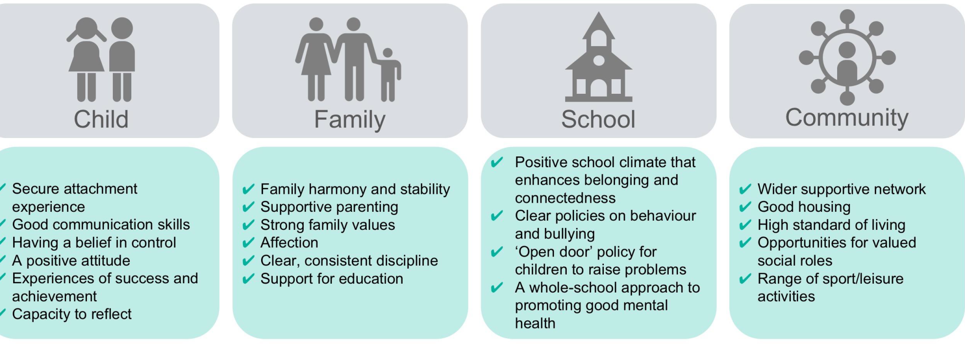
What Helps a Child Develop Resilience?
Notes:
A childs individual temperament contributes only a little to their resilience – their experiences, relationships with peers, school environment and community are also large factors to childrens wellbeing. Children learn to be resileint

Slide 8

5 Ways to Mental Wellbeing
Connect – with other people, talk, spend time with family and friends
Be Active – physical exercise, walking,
Take Notice – ‘Be in the moment’, notice what’s going on around you in the present
Learn – do a crossword, read a book, learn a new skill, attend a workshop!
Give – help others, engage in your community
Notes:
Important for parents to stay mentally well in order to increase childs protective factors
what can we do to look after our mental wellbeing? Or talk it through in pairs

Slide 9
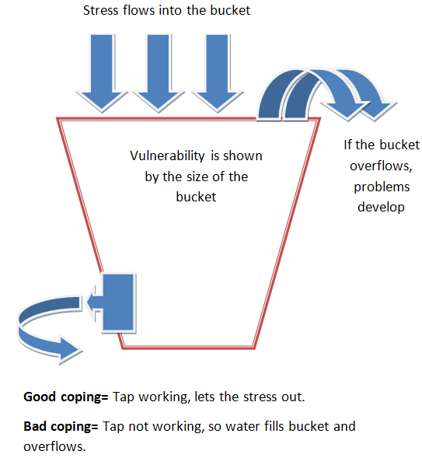
The Stress Bucket
Notes:
Explain the model and then give everybody blank stress bucket to think about their own (or their child’s) circumstances and coping strategies
How would they notice ‘the over flow’ in their child?
Problems that might develop – things to look out for:
Tiredness and change in sleep routine
Change in appetite / extreme weight gain or loss
Lack of concentration
Physical symptoms – headaches, shaking, jumpy, sickness
Withdrawal
Hopelessness for future
Increase in risk taking behaviour
Change in engagement in school
Avoiding activities they previously enjoyed

Slide 10

What Helps?
Think of a time you have recovered from something. What helped?
Notes:
Think of when you recovered from something – could be an injury, illness, mental health difficulty, life event …
What helped your recovery – write 3 things down on post its and put the post it on a board in the room
When everyone has done this return to the board and see what the main things are that help us recover

Slide 11
Tips for talking to your child
https://www.youtube.com/watch?v=r_yAtOh3yV0
Anna Freud National Centre for Children and Families
Notes:
5 min video

Slide 12
How to Talk and How to Listen
Make talking about mental health a normal everyday part of life
Give it your full attention and take it seriously
Positive body language
Ask open questions
Stay calm
Offer empathy rather than solutions
Encourage your child to think of what might help (give them control)
Notes:
Group exercise
Talk about your journey here today

Slide 13
Mental Health First Aid
Daylight
Healthy diet
Good sleep habits
Confronting fears
Relaxation techniques – breathing exercises
Limit screen time
Play
Liaise with school
Enable your child to get appropriate help if required

Slide 14
Concerned About Your Child’s Mental Health?
Step 1 – Talk, listen, empathise, encourage your child to find their own solutions and build resilience
Step 2 - MindEd – over 300 topics about mental health for parents (and professionals) www.minded.org.uk
Step 3 - CAMHS website www.mymind.org.uk for resources
Whilst – Liaising with school to develop support plans
Still Concerned? - CAMHS Advice Line – 0151 488 8453 (9am -10pm Mon – Friday, 12-8pm weekends and bank holidays)
Notes:
To recap - Talking to your child about feelings/emotions.
How do you and your child manage your stress buckets?
Help your child build resilience - Standing back and allowing your child to sort out their own problems
Managing our own emotions when our child is distressed.
Access more advice if required
Leaflets about advice line available and leaflets about talking about mental health

Slide 15
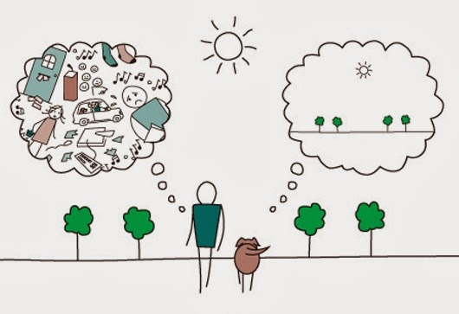
Mindfulness
Lets try a 3 minute body scan meditation?
https://youtu.be/ihwcw_ofuME
Notes:
Alternative – download Headspace on your phone

Slide 16

Thank you!
Any questions?
Please complete our evaluations
Interested in ‘train the trainer training’? Leave details on evaluation and we will be in touch!

